Slide 1


Kyaw Zin Oo
22 August 2025

Slide 2

Outline
Executive Summary
Introduction
Methodology
Results
Conclusion
Appendix

Slide 3
Executive Summary
Summary of methodologies
Data Collection through API
Data Collection with Web Scraping
Data Wrangling
Exploratory Data Analysis with SQL
Exploratory Data Analysis with Data Visualization
Interactive Visual Analytics with Folium
Machine Learning Prediction
Summary of all results
Exploratory Data Analysis result
Interactive analytics in screenshots
Predictive Analytics result

Slide 4
Introduction
Project background and context
SpaceX advertises Falcon 9 rocket launches at a cost of $62 million, compared to over $165 million charged by other providers. The significant cost advantage comes from SpaceX’s ability to reuse the first stage of the rocket. Therefore, predicting whether the first stage will land successfully is key to estimating launch costs. This information is also valuable for competitors seeking to bid against SpaceX. The objective of this project is to develop a machine learning pipeline that can predict the likelihood of a successful first-stage landing.
Problems you want to find answers
What factors determine if the rocket will land successfully?
The interaction amongst various features that determine the success rate of a successful landing.
What operating conditions needs to be in place to ensure a successful landing program.

Slide 5

Section 1

Slide 6
Methodology
Executive Summary
Data collection methodology:
Data was collected using SpaceX API and web scraping from Wikipedia.
Perform data wrangling
One-hot encoding was applied to categorical features
Perform exploratory data analysis (EDA) using visualization and SQL
Perform interactive visual analytics using Folium and Plotly Dash
Perform predictive analysis using classification models
How to build, tune, evaluate classification models

Slide 7
Data Collection
Describe how data sets were collected.
Data was collected through a GET request to the SpaceX API. The response was decoded into JSON format using the .json() function and converted into a Pandas DataFrame with .json_normalize(). The dataset was then cleaned, checked for missing values, and corrected where necessary.
In addition, web scraping was performed on Wikipedia using BeautifulSoup to gather Falcon 9 launch records. The launch data was extracted from the HTML tables, parsed, and converted into a Pandas DataFrame for further analysis.

Slide 8
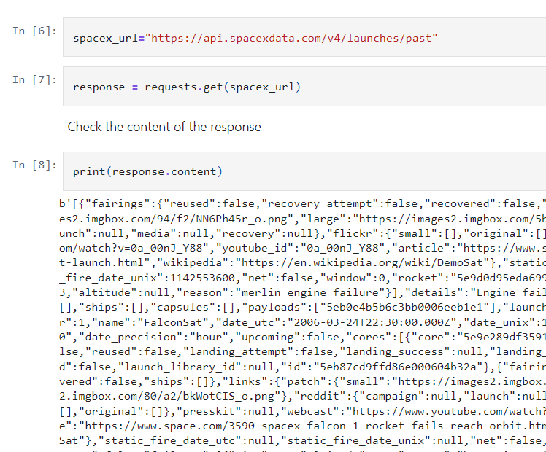
Data Collection – SpaceX API
We collected data using a GET request to the SpaceX API, then cleaned, wrangled, and formatted the dataset to prepare it for analysis.
The link to the notebook is https://github.com/kyawzo/test_repo/blob/main/jupyter-labs-spacex-data-collection-api.ipynb

Slide 9
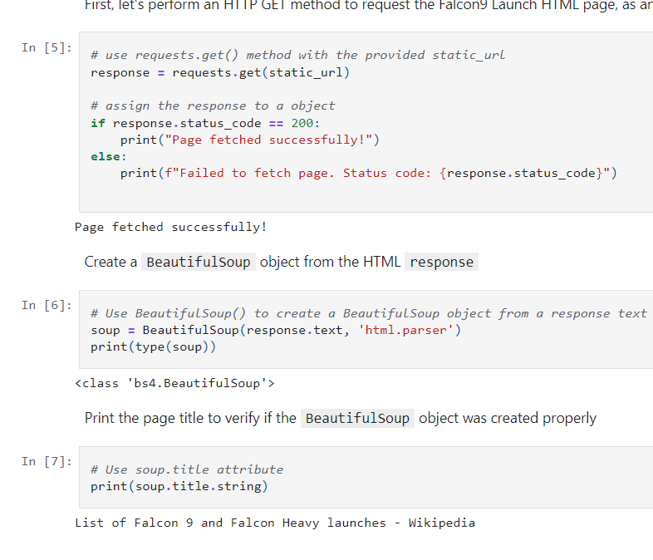
Data Collection - Scraping
We used web scraping with BeautifulSoup to extract Falcon 9 launch records, then parsed the table data and converted it into a pandas dataframe for analysis.
The link to the notebook is https://github.com/kyawzo/test_repo/blob/main/jupyter-labs-webscraping.ipynb

Slide 10
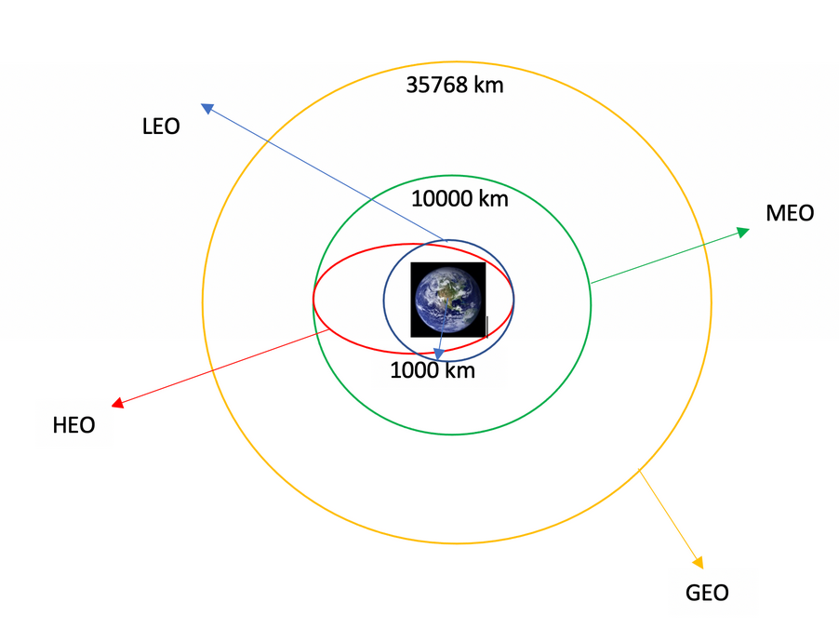
Data Wrangling
We conducted exploratory data analysis (EDA) to define the training labels. This included calculating the number of launches at each site and analyzing the frequency and distribution of different orbits.
We also created a landing outcome label from the outcome column and exported the processed results to a CSV file.
The link to the notebook is https://github.com/kyawzo/test_repo/blob/main/labs-jupyter-spacex-Data%20wrangling.ipynb

Slide 11
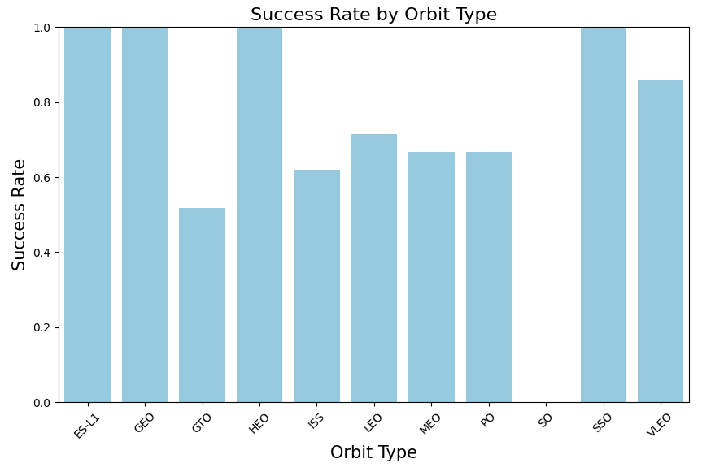
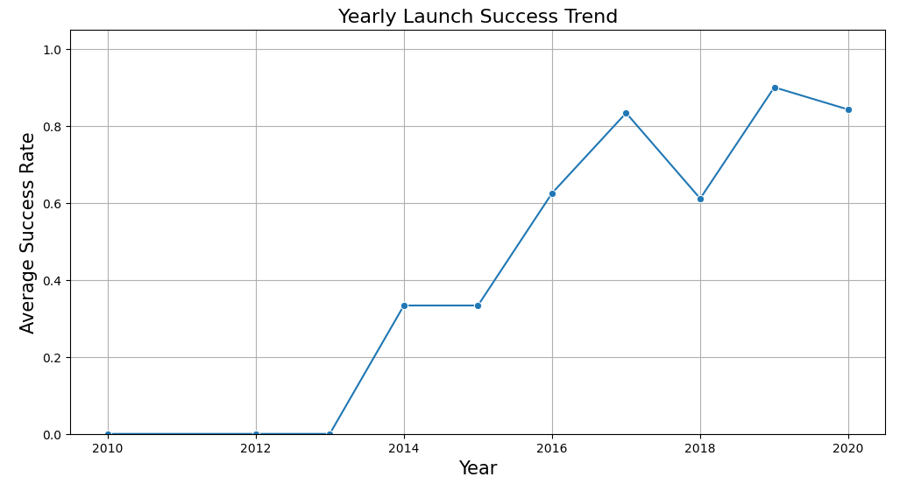
EDA with Data Visualization
We analyzed the data through visualizations to examine the relationship between flight number and launch site, payload and launch site, the success rate of each orbit type, the association between flight number and orbit type, and the yearly trend of launch success.
The link to the notebook is https://github.com/kyawzo/test_repo/blob/main/edadataviz.ipynb

Slide 12
EDA with SQL
We loaded the SpaceX dataset into a PostgreSQL database directly from the Jupyter notebook. Using SQL for exploratory data analysis (EDA), we generated insights by writing queries to answer questions such as:
What are the names of the unique launch sites in the missions?
What is the total payload mass carried by boosters launched under NASA (CRS)?
What is the average payload mass carried by the booster version F9 v1.1?
How many missions resulted in success and failure outcomes?
Which landings failed on drone ships, and what were their corresponding booster versions and launch sites?
The link to the notebook is https://github.com/kyawzo/test_repo/blob/main/jupyter-labs-eda-sql-coursera_sqllite.ipynb

Slide 13
Build an Interactive Map with Folium
We visualized all launch sites on a Folium map, enhancing it with markers, circles, and lines to indicate the success or failure of launches at each site.
Launch outcomes were classified as 0 (failure) or 1 (success). By using color-coded marker clusters, we were able to identify which launch sites demonstrated higher success rates.
Additionally, we calculated distances from each launch site to nearby infrastructure and natural features. This allowed us to address questions such as:
Are the launch sites located near railways, highways, or coastlines?
Do launch sites maintain a certain distance from cities?
The link to the notebook is https://github.com/kyawzo/test_repo/blob/main/lab_jupyter_launch_site_location.ipynb

Slide 14
Build a Dashboard with Plotly Dash
We developed an interactive dashboard using Plotly Dash. The dashboard includes:
Pie charts illustrating the total number of launches at each site.
Scatter plots visualizing the relationship between launch outcomes and payload mass (kg) across different booster versions.
The link to the notebook is https://github.com/kyawzo/test_repo/blob/main/spacex-dash-app.py

Slide 15
Predictive Analysis (Classification)
We loaded the data using NumPy and Pandas, performed data transformations, and split it into training and testing sets.
We built multiple machine learning models and tuned their hyperparameters using GridSearchCV.
Model performance was evaluated using accuracy, and we further improved results through feature engineering and algorithm optimization.
Finally, we identified the best-performing classification model.
The link to the notebook is https://github.com/kyawzo/test_repo/blob/main/SpaceX_Machine%20Learning%20Prediction_Part_5.ipynb

Slide 16
Results
Exploratory data analysis results
Interactive analytics demo in screenshots
Predictive analysis results

Slide 17

Section 2

Slide 18
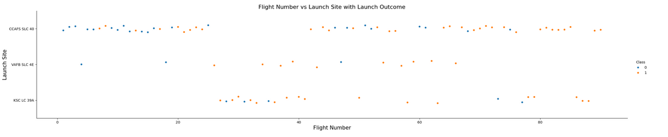
Flight Number vs. Launch Site
From the plot, we found that the larger the flight amount at a launch site, the greater the success rate at a launch site.

Slide 19
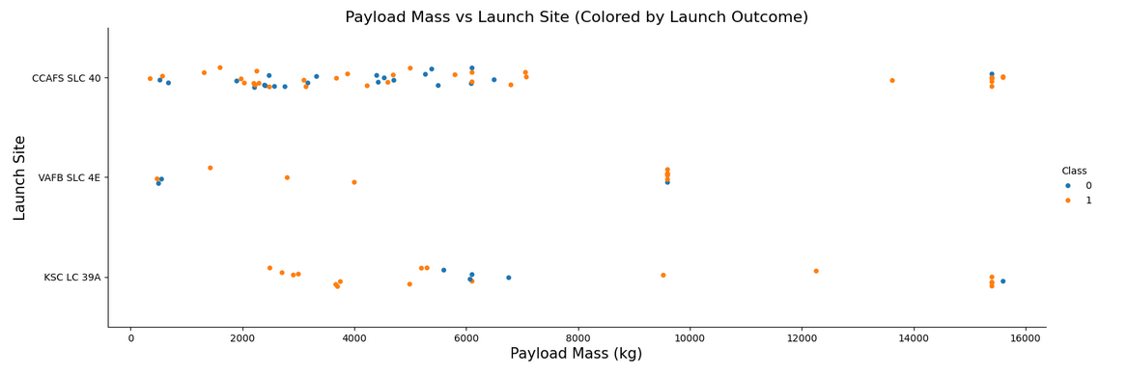
Payload vs. Launch Site
The plot shows launches from three different sites: CCAFS SLC 40, VAFB SLC 4E, and KSC LC 39A.
The majority of the launches appear to be successful (blue points) across all three sites.
The plot reveals that failed launches (orange points) occurred at various payload masses from all three launch sites.

Slide 20
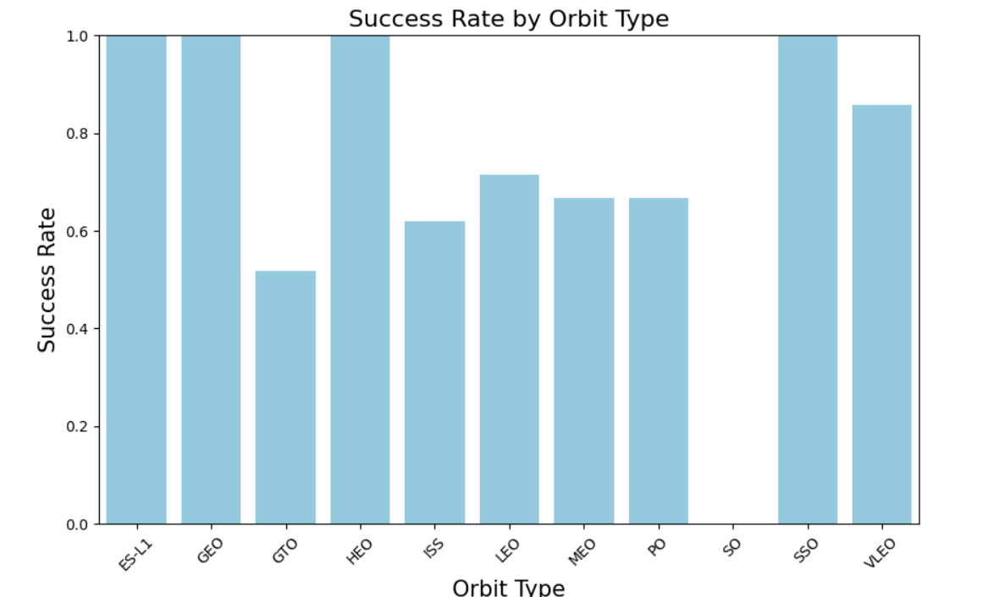
Success Rate vs. Orbit Type
From the plot, we can see that ES-L1, GEO, HEO, SSO, VLEO had the most success rate.

Slide 21
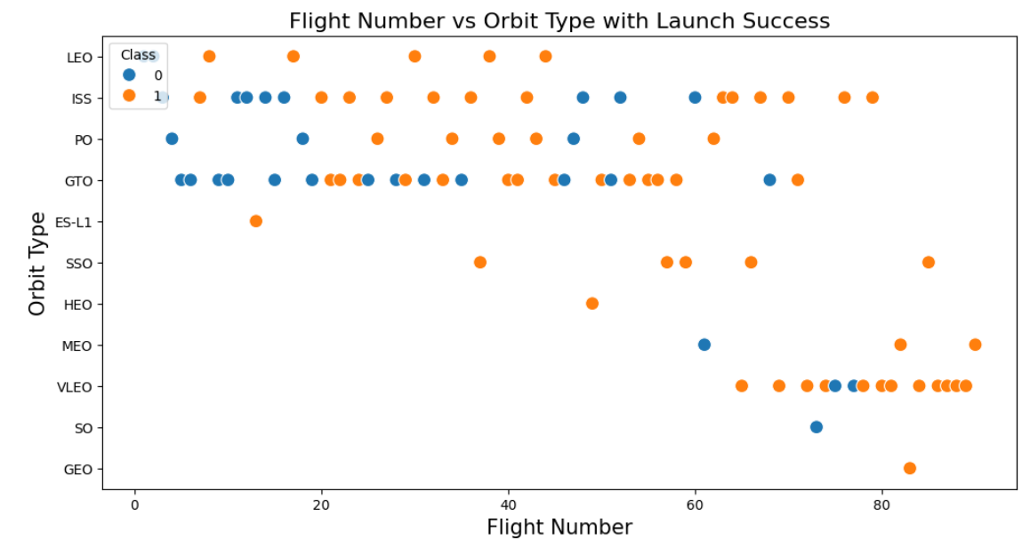
Flight Number vs. Orbit Type
The plot below shows the Flight Number vs. Orbit type.
We observe that in the LEO orbit, success is related to the number of flights whereas in the GTO orbit, there is no relationship between flight number and the orbit.

Slide 22
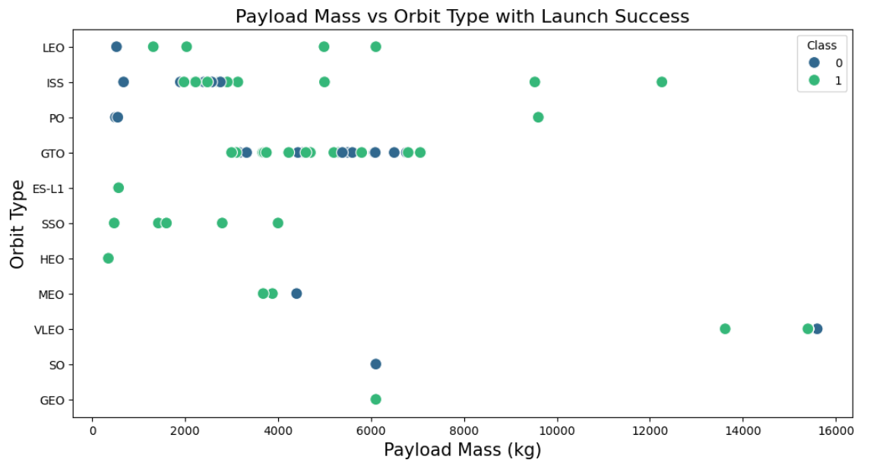
Payload vs. Orbit Type
We can observe that with heavy payloads, the successful landing are more for PO, LEO and ISS orbits.

Slide 23
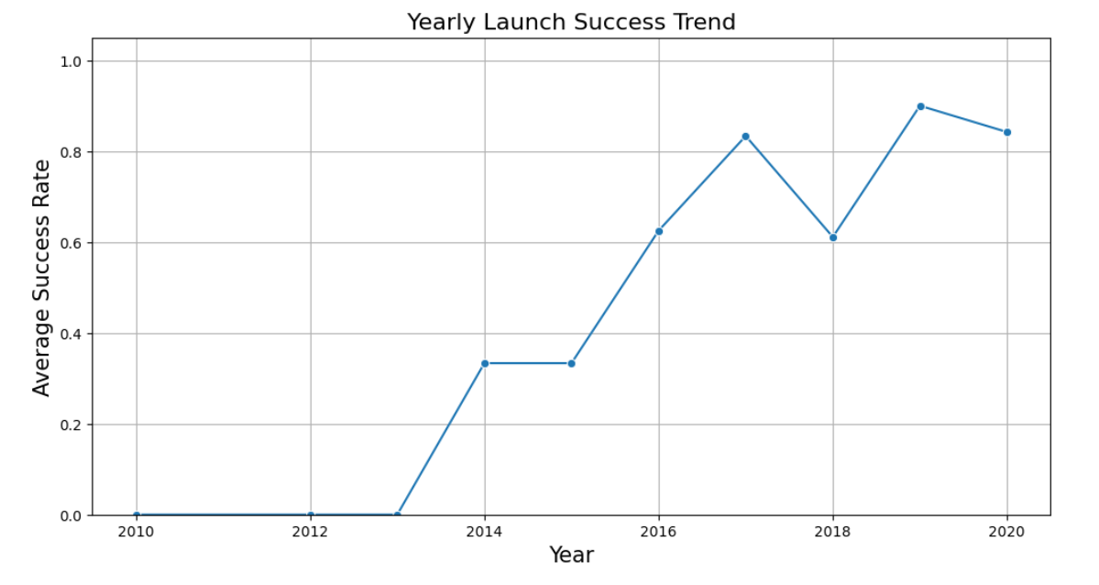
Launch Success Yearly Trend
We can observe that the success rate since 2013 kept increasing till 2020

Slide 24
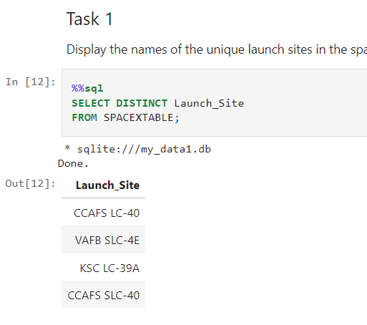
All Launch Site Names
We used the key word DISTINCT to extract the unique launch sites from the SpaceX data.

Slide 25
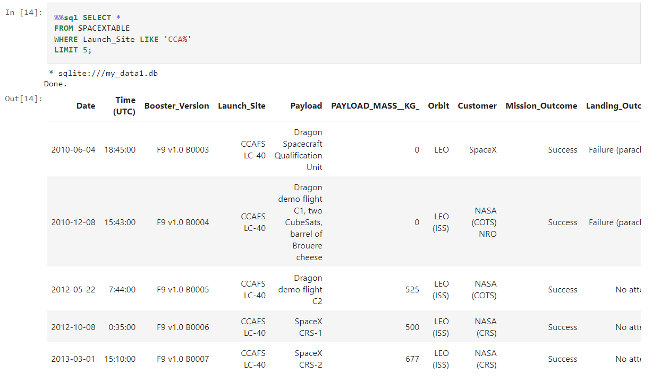
Launch Site Names Begin with 'CCA'
We used the key word LIMIT to extract 5 records and LIKE keyword to extract the Launch_Site start with “CCA”

Slide 26
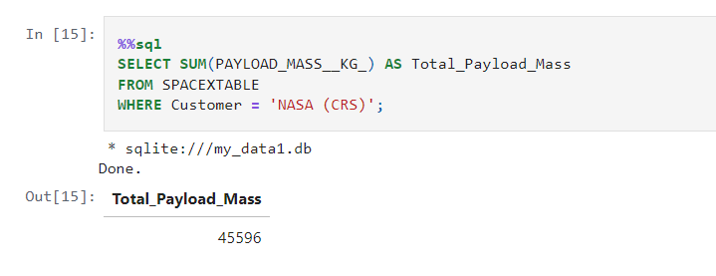
Total Payload Mass
Used SUM command to summarized the payload.

Slide 27
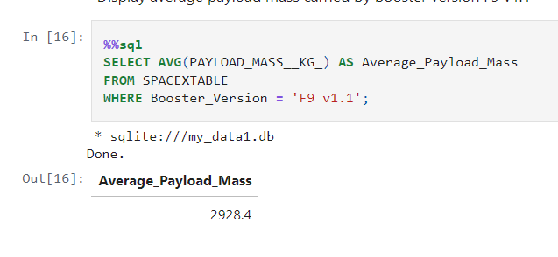
Average Payload Mass by F9 v1.1
Used AVG command to find the average of Payload Mass for booster version F9 v1.1

Slide 28
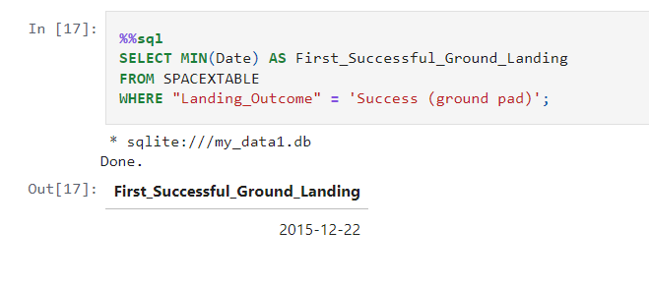
First Successful Ground Landing Date
Used MIN command to find the minimum of First Successful Ground Landing outcome for booster version F9 v1.1

Slide 29
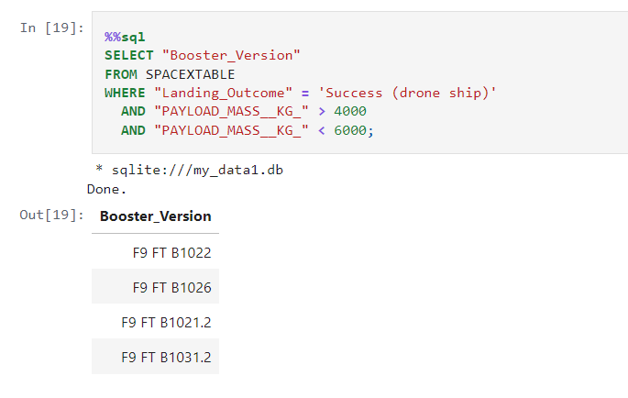
Successful Drone Ship Landing with Payload between 4000 and 6000
Used the WHERE clause to filter for boosters which have successfully landed on drone ship and applied the AND condition to determine successful landing with payload mass greater than 4000 but less than 6000

Slide 30
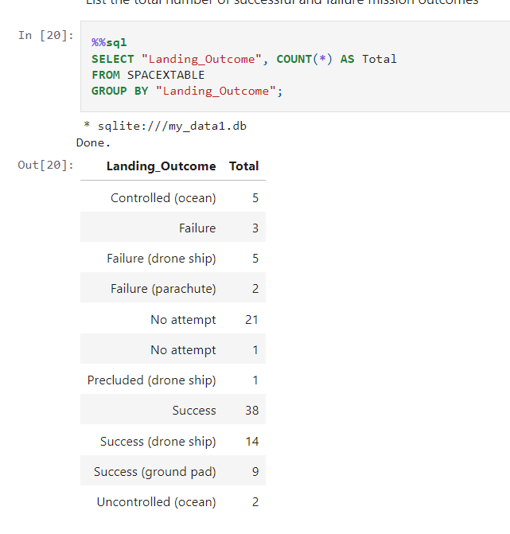
Total Number of Successful and Failure Mission Outcomes
Extract and count the different status of landing outcome.

Slide 31
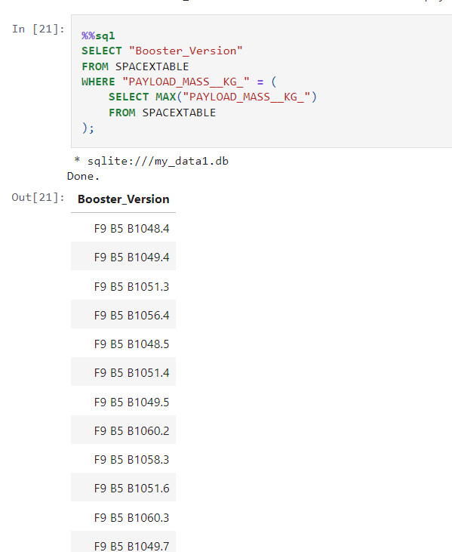
Boosters Carried Maximum Payload
Extracted the booster which have carried the maximum payload mass using subquery

Slide 32
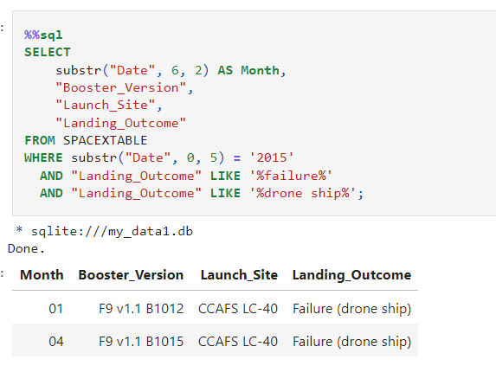
2015 Launch Records
Extracted the list of failed landing_outcomes in drone ship, their booster versions, and launch site names for in year 2015

Slide 33
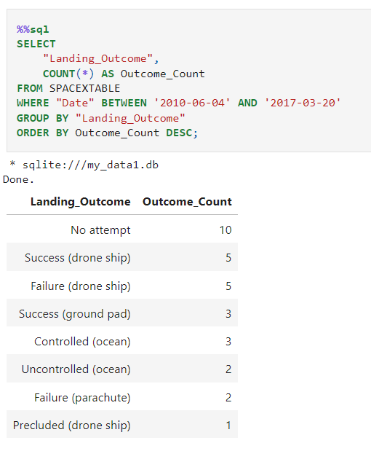
Rank Landing Outcomes Between 2010-06-04 and 2017-03-20
We selected Landing outcomes and the COUNT of landing outcomes from the data and used the WHERE clause to filter for landing outcomes BETWEEN 2010-06-04 to 2010-03-20.
We applied the GROUP BY clause to group the landing outcomes and the ORDER BY clause to order the grouped landing outcome in descending order.

Slide 34

Section 3

Slide 35
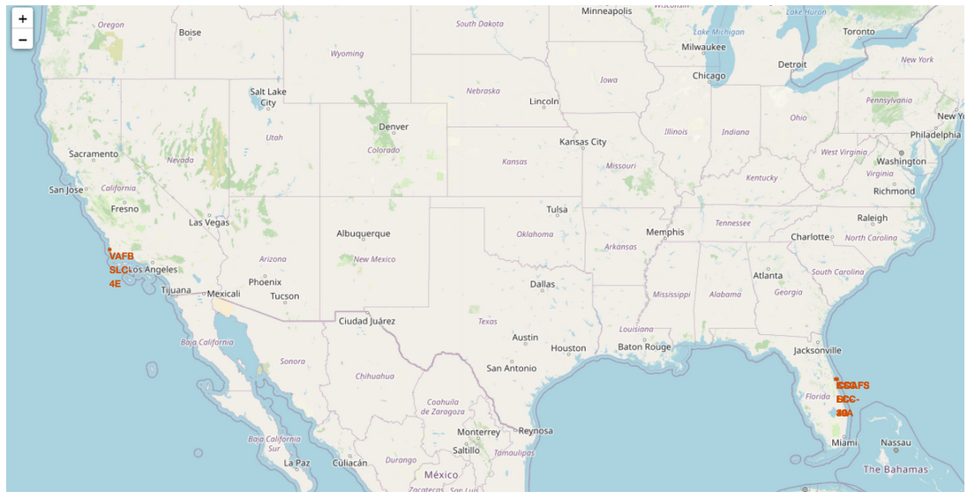
All launch sites global map markers
We can see that the SpaceX launch sites are in the United States of America Florida and California.

Slide 36
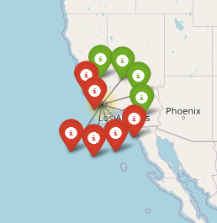
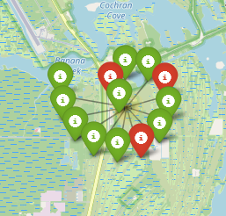
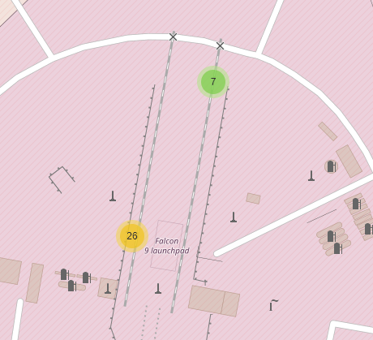
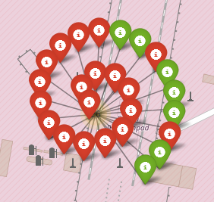
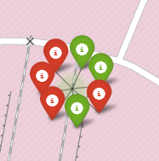
Markers showing launch sites with color labels
Green Marker shows successful Launches and Red Marker shows Failures
California Launch Site
Florida Launch Site

Slide 37
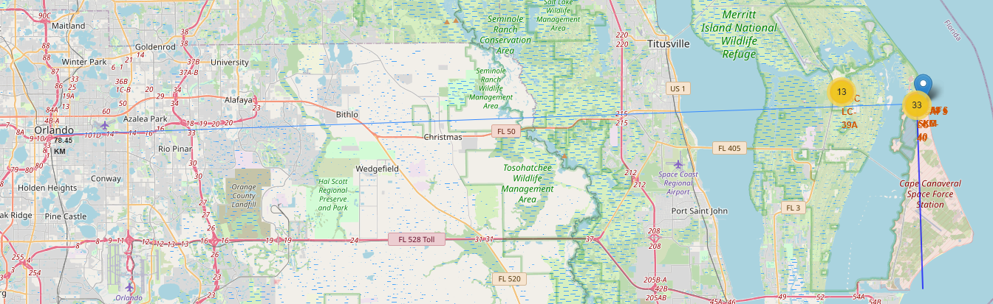
Launch Site distance to landmarks
Are launch sites in close proximity to railways? No.
Are launch sites in close proximity to highways? No.
Are launch sites in close proximity to coastline? Yes
Do launch sites keep certain distance away from cities? Yes

Slide 38

Section 4

Slide 39
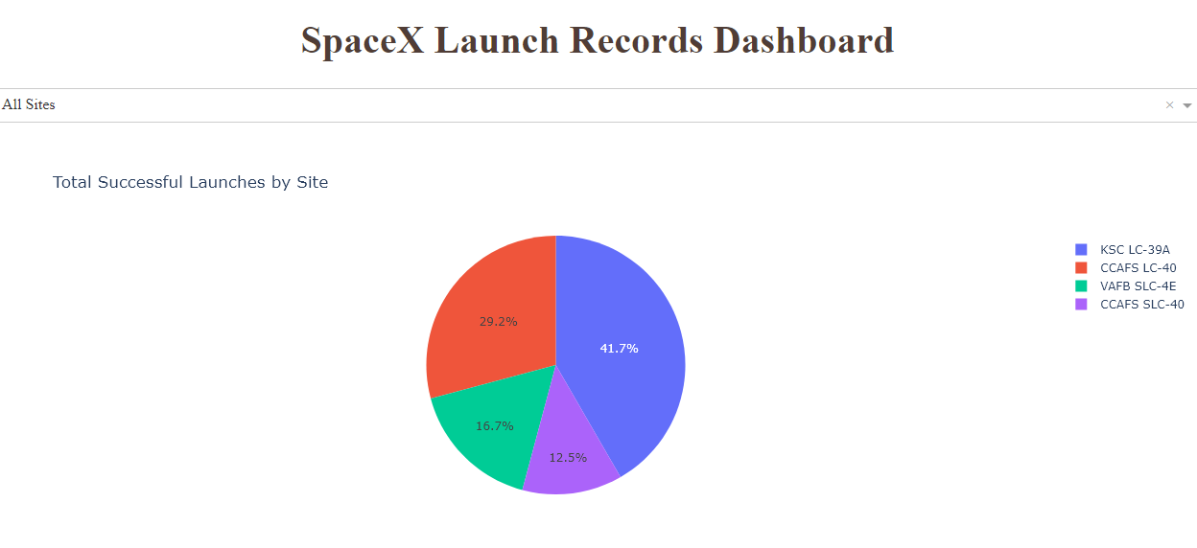
Pie chart showing the success percentage achieved by each launch site
Can see that KSC LC-39A had the most successful launches from all the sites

Slide 40
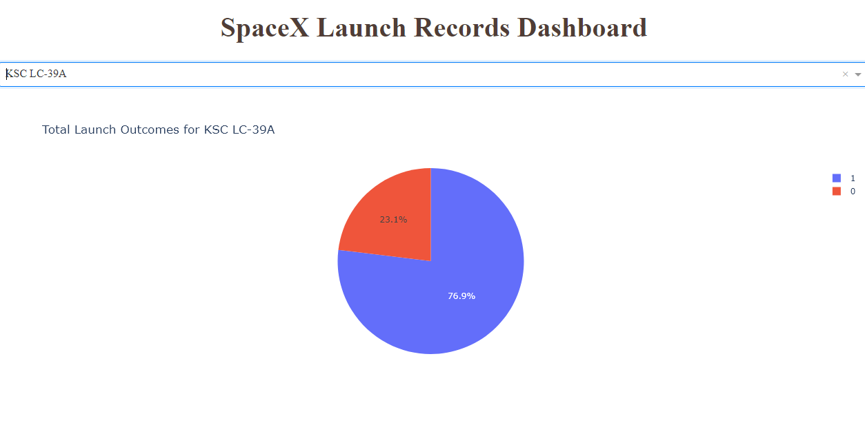
Pie chart showing the Launch site with the highest launch success ratio
KSC LC-39A achieved a 76.9% success rate while getting a 23.1% failure rate

Slide 41
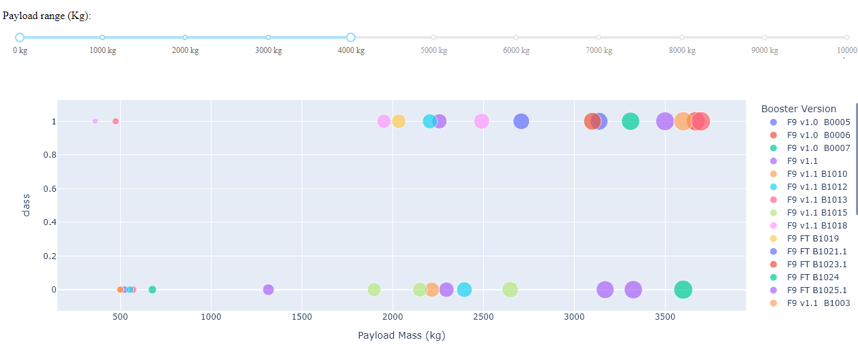
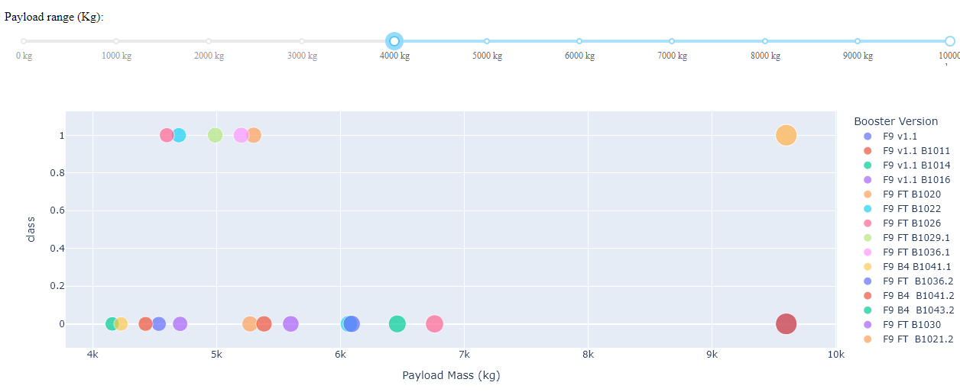
Scatter plot of Payload vs Launch Outcome for all sites, with different payload selected in the range slider
Low weighted payload 0kg-4000kg
Heavy weighted payload 4000kg-10000kg
We can see the success rates for low weighted payloads is higher than the heavy weighted payloads.

Slide 42

Section 5

Slide 43
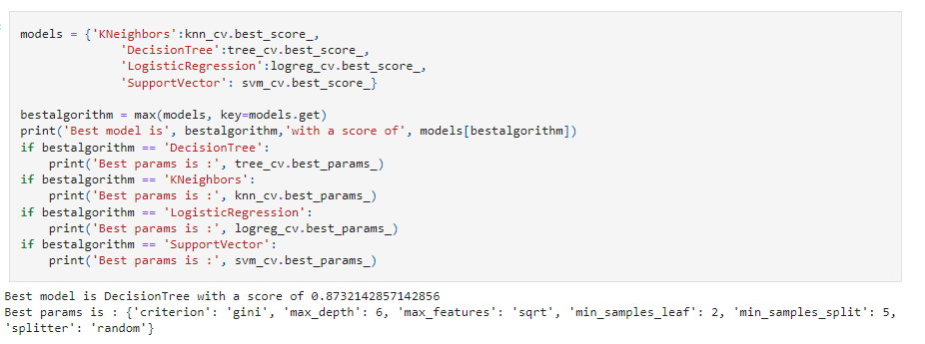
Classification Accuracy
The decision tree classifier is the model with the highest classification accuracy

Slide 44
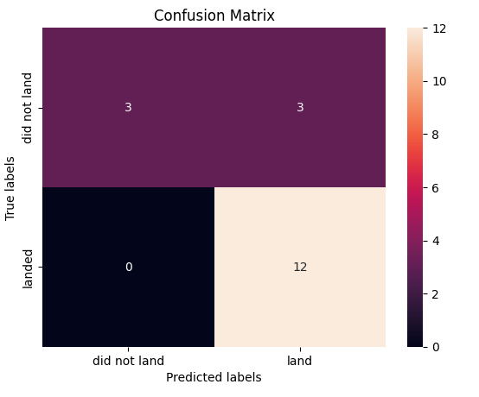
Confusion Matrix
The confusion matrix for the decision tree classifier shows that the classifier can distinguish between the different classes. The major problem is the false positives .i.e., unsuccessful landing marked as successful landing by the classifier.

Slide 45
Conclusions
We can conclude the following:
The larger the number of flights at a launch site, the higher the success rate at that site.
Launch success rates increased steadily from 2013 to 2020.
Orbits ES-L1, GEO, HEO, SSO, and VLEO achieved the highest success rates.
KSC LC-39A had the most successful launches among all sites.
The Decision Tree Classifier was the best-performing machine learning algorithm for this task.

Slide 46


